Slide 1






Dynamic Supply Chain Logistics Analytics📦
Team Members:
Ziad Khaled Seif El-Deen Ahmed
Abdelrhman Ahmed Mohamed Hymeda
Sama Mahmoud Reneh Romany
Mohamed Rafaat

Slide 2




Table of Content
Explore Data with Python
Analysis Questions Phase
Forcasting Questions Phase
Dashboard Overview

Slide 3

Explore Data with Python

Slide 4
Dataset Overview & Structure
Dataset Description:
This dataset simulates operations from a modern logistics network in Southern California, spanning from January 2021 to January 2024.
It includes hourly records of key activities such as transportation, warehouse operations, inventory levels, and real-time GPS tracking.
The data was generated from systems like IoT sensors, vehicle trackers, and supply chain platforms, making it ideal for analysis of delivery performance, risk exposure, and operational efficiency.

Slide 5
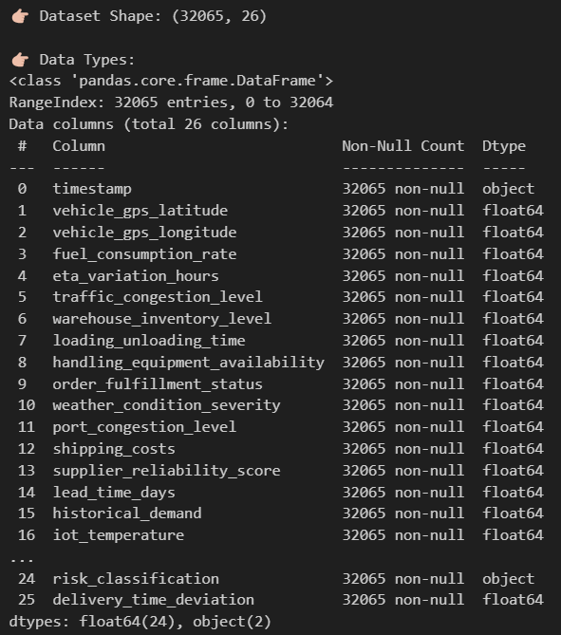
Dataset Overview & Structure
Size: 32,065 rows × 26 columns
Data Types: 24 numerical, 2 categorical (timestamp, risk_classification)
Key Domains:
Time-based: timestamp
Location-based: vehicle GPS coordinates
Performance-based: delivery time deviation, ETA variation
Risk-related: disruption score, route risk level, delay probability

Slide 6
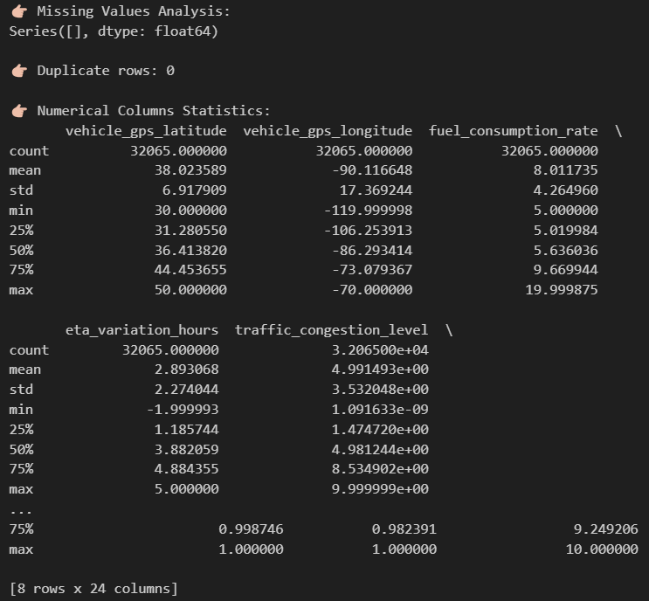
Data Cleaning & Validation
Missing Values: None found across all columns
Duplicates: 0 duplicate rows
Timestamp Conversion: Converted to datetime for time-based analysis
Data Types: Confirmed using .info() and .describe() in pandas

Slide 7
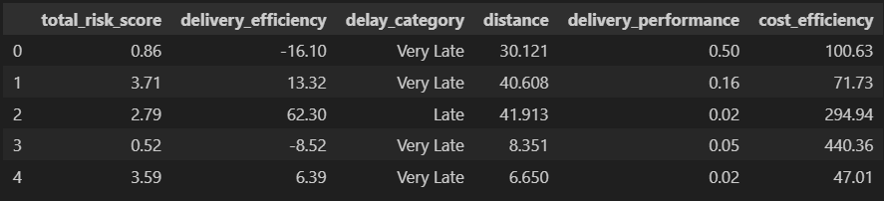
Feature Engineering & New Columns
Risk Metrics: total_risk_score (scale: 0–1, Higher = higher overall risk)
Performance Metrics:
delivery_efficiency: score out of 100 % (Higher = better timing accuracy)
delivery_performance: score out of 100 % (Near 100 = perfect delivery, Near 0 = bad)
Efficiency Metric:
cost_efficiency: score out of 100 %,(>100 = more efficient, <100 = less efficient)
Delay Labels: (e.g., Very Early, On Time, Very Late)
Distance Feature: GPS shifts (approximate km)

Slide 8
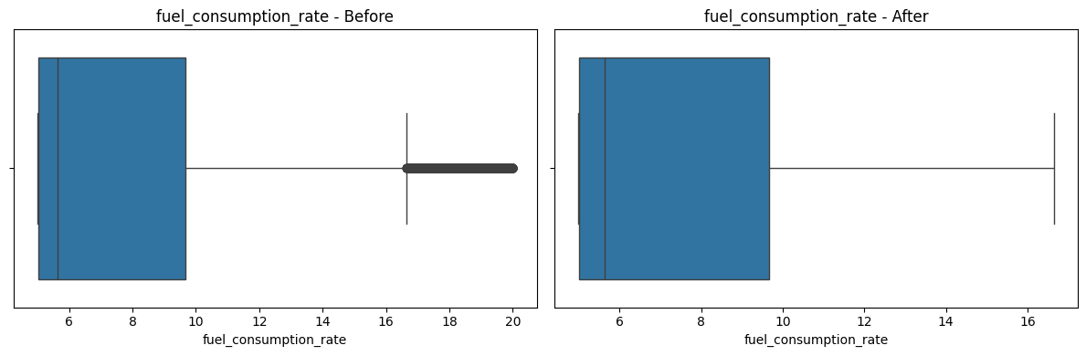
Outlier Detection & Handling
Technique Used: Interquartile Range (IQR Method)
Columns Excluded:
Engineered metrics: delivery_performance, delivery_efficiency, cost_efficiency
Probabilities: delay_probability, driver_behavior_score, etc.
Clipping Method: .clip(lower, upper) instead of deleting rows
Visualization: Boxplots used to confirm distributions pre/post handling
Result: 6,363 total outliers handled safely without harming metric integrity
Ex: fuel_consumption_rate - Outliers: 2536 (7.91%)

Slide 9
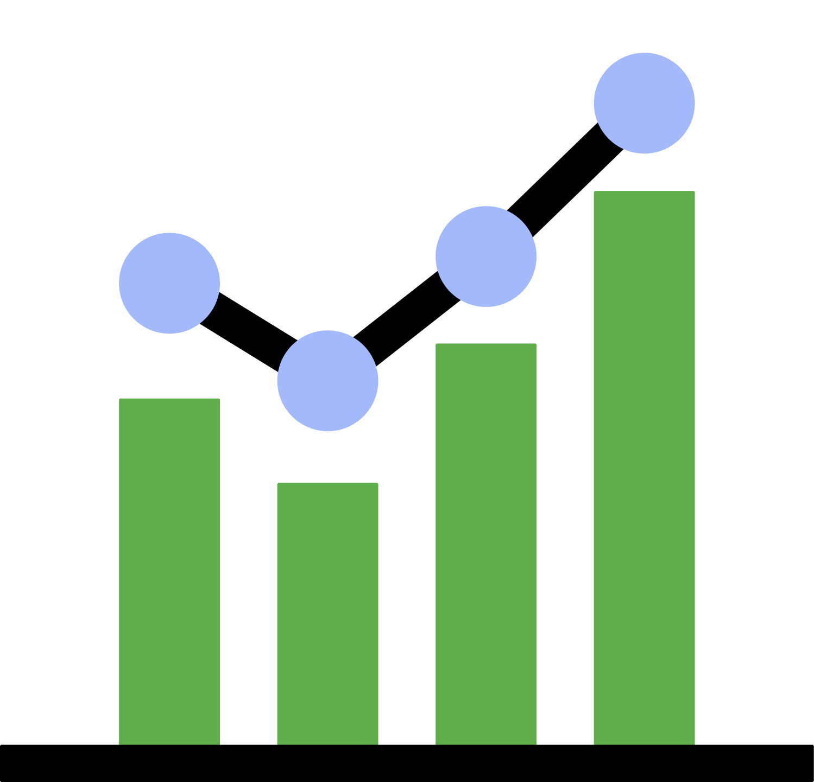
Analysis Questions Phase

Slide 10
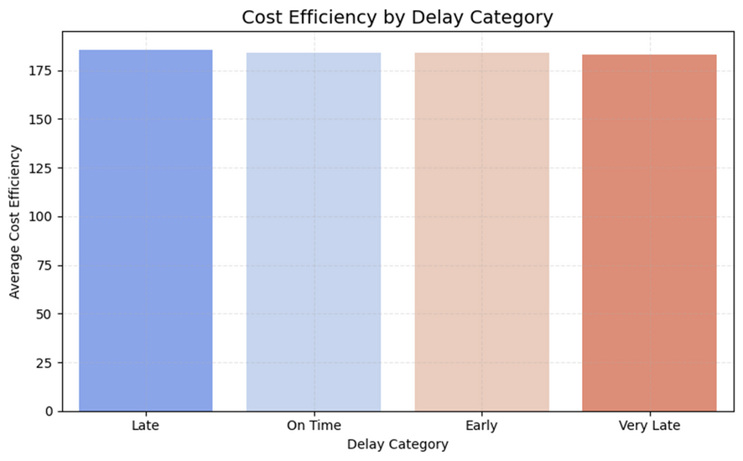
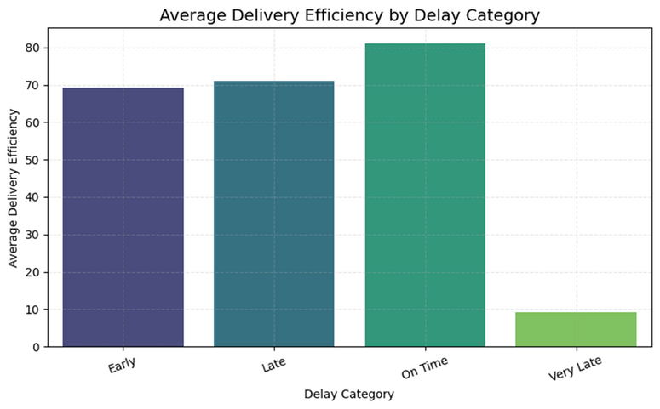
Fuel & Efficiency Analysis
Average fuel consumption
Cost efficiency vary across different delay categories
Insight: This metric highlights overall fuel efficiency. A value of 7.74 liters suggests moderate fuel usage, but outliers (e.g., values like 19.9 liters) indicate potential inefficiencies in specific vehicles or routes
Project Impact: Identifies opportunities for fuel optimization, such as adopting fuel-efficient vehicles or optimizing routes. It prompts discussions on sustainability and cost reduction strategies.
Discussion Points: Are high fuel consumption rates tied to specific vehicle types or routes? Can alternative fuels or hybrid vehicles reduce costs?
Insight: Costs are highest for Early deliveries, possibly due to expedited efforts, and Very Late deliveries, likely due to penalties or inefficiencies. On-Time and Late categories show slightly lower costs, indicating better cost efficiency.
Project Impact: Highlights the financial burden of delays, guiding strategies to prioritize on-time deliveries or recover costs for early shipments.
Discussion Points: Why are early deliveries costly? Can process improvements reduce Very Late delivery costs?

Slide 11
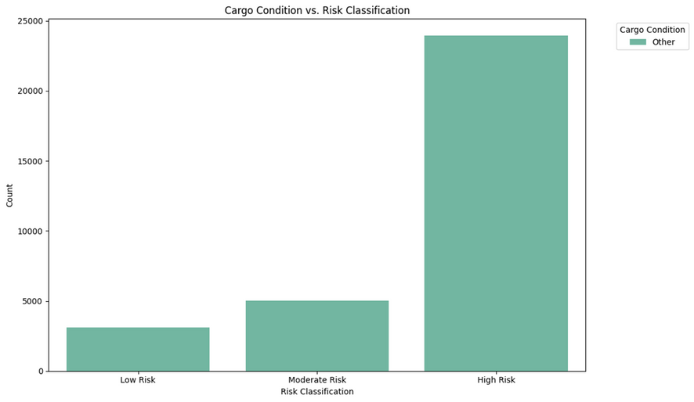
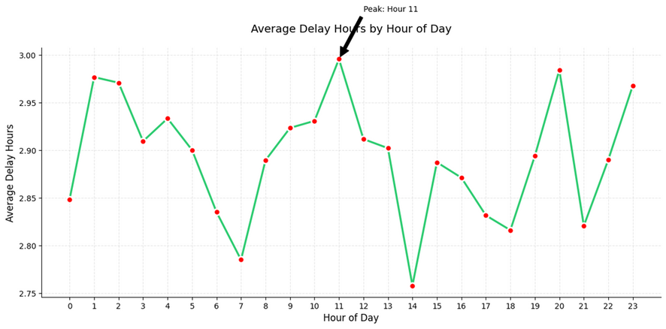
Delays & Time Analysis
During which hour of the day do deliveries experience the highest average delay
ETA Variation by Weekday
Insight: A significant 78.51% of deliveries are classified as High Risk, indicating substantial risk exposure, possibly due to factors like route risks or cargo conditions.
Project Impact: Highlights the need for enhanced risk management, such as better route planning or cargo monitoring, to reduce high-risk cases.
Discussion Points: What factors (e.g., route, weather, cargo) drive high-risk classifications? Can targeted interventions lower risk levels?
Insight: Peak delays at 10:00 AM suggest morning traffic or operational bottlenecks, such as warehouse processing delays.
Project Impact: Informs scheduling adjustments or route planning to avoid peak delay hours, improving delivery reliability.
Discussion Points: Are 10:00 AM delays due to traffic, staffing, or warehouse issues? Can deliveries be rescheduled to off-peak hours?

Slide 12
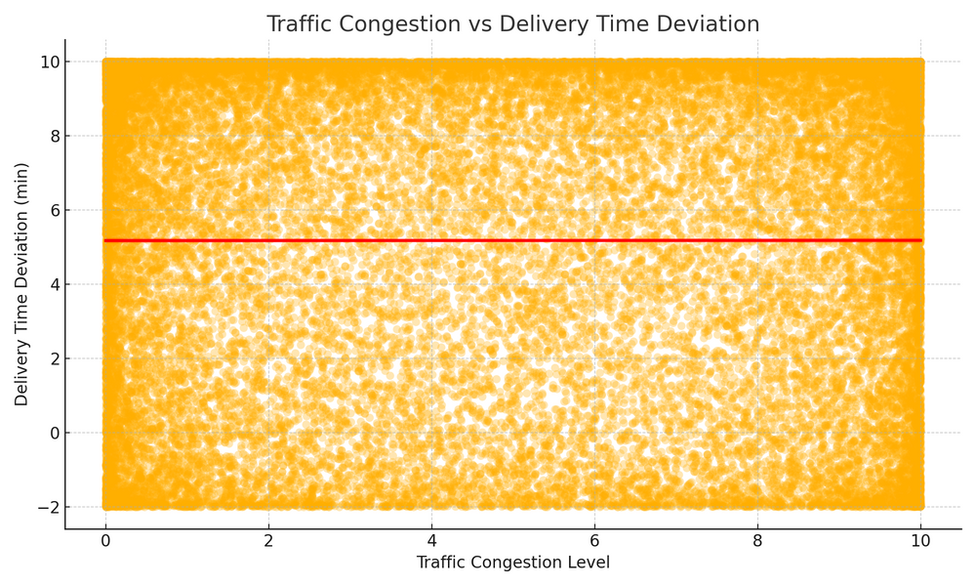
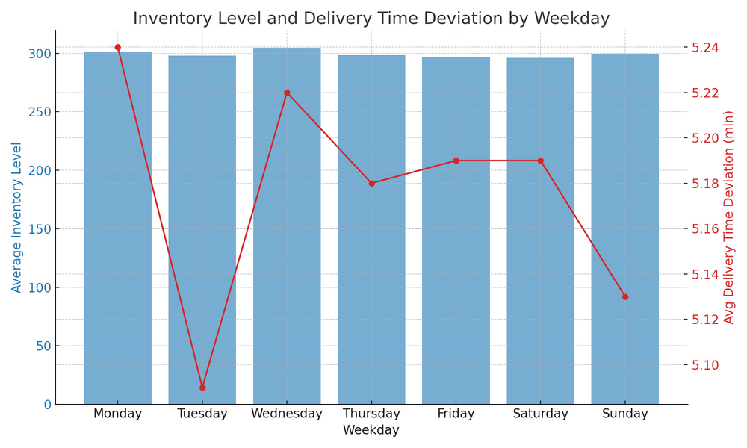
Risk & Performance Analysis
How does traffic congestion correlate with delivery time deviation
Relationship between warehouse inventory levels and delivery performance across days of the week
Insight: The weak correlation suggests traffic congestion is not a primary driver of delays in this dataset, possibly due to effective route planning or other dominant factors (e.g., warehouse delays).
Project Impact: Encourages exploration of other delay causes while maintaining basic traffic monitoring, as congestion has minimal impact.
Discussion Points: Why is congestion’s impact low? Are there specific routes where congestion matters more?
Insight: Inventory levels remain relatively stable (~297 units), but delays peak on Wednesday (4.79 minutes) and are lowest on Tuesday (4.41 minutes), suggesting possible inventory processing inefficiencies on certain days.
Project Impact: Guides inventory replenishment schedules and warehouse staffing to reduce delays, particularly on high-delay days like Thursday.
Discussion Points: Do Wednesday delays correlate with inventory processing bottlenecks? Can inventory adjustments improve Tuesday’s performance further?

Slide 13

Forcasting Questions Phase

Slide 14
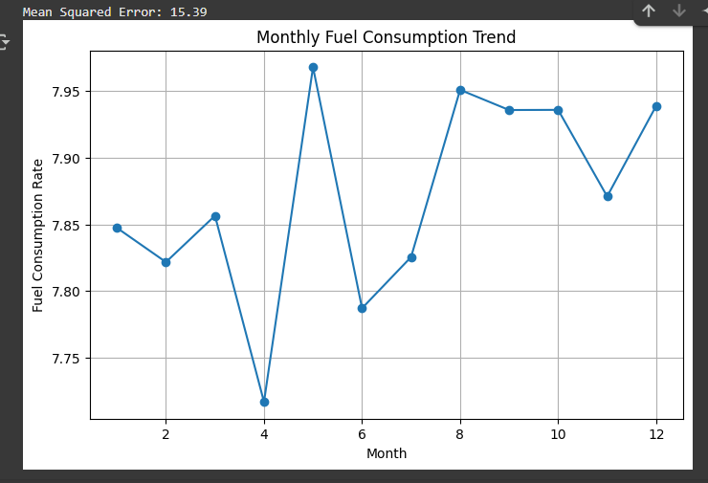
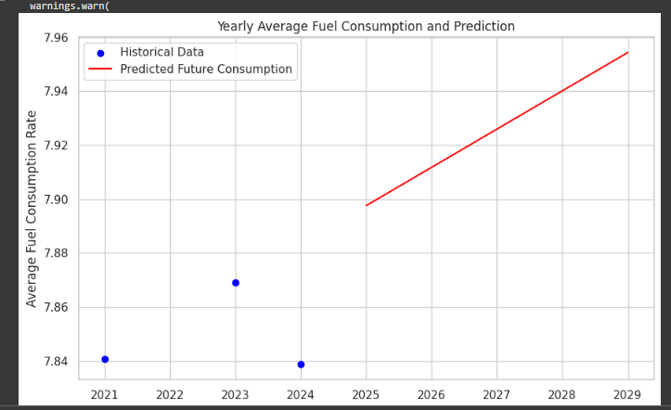
Fuel & Efficiency Analysis
Fuel consumption prediction
Delivery fuel consumption forecast
Analysis: The mean error (MSE = 15.39) shows acceptable accuracy. The model predicted higher fuel consumption in May, August, and December, which helps improve planning and reduce waste
Project impact: The project helps improve fuel efficiency by predicting critical periods, which contributes to reducing costs, minimizing environmental impact, and supporting operational decisions.
Discussion topic: How can fuel consumption forecasting be used to improve operational efficiency and reduce environmental costs in organizations?
Analysis : The results show a decrease in fuel consumption in deliveries over the past few years, and this is expected to continue in the future. This is due to new combat vehicle technologies that enable more efficient delivery.
Project Impact : The project helps reduce fuel consumption and operating costs, lowers environmental impact, and enhances the efficiency and effectiveness of delivery operations.
Discussion topic : How will technological developments and modern delivery methods impact fuel consumption in delivery operations in the coming years?

Slide 15
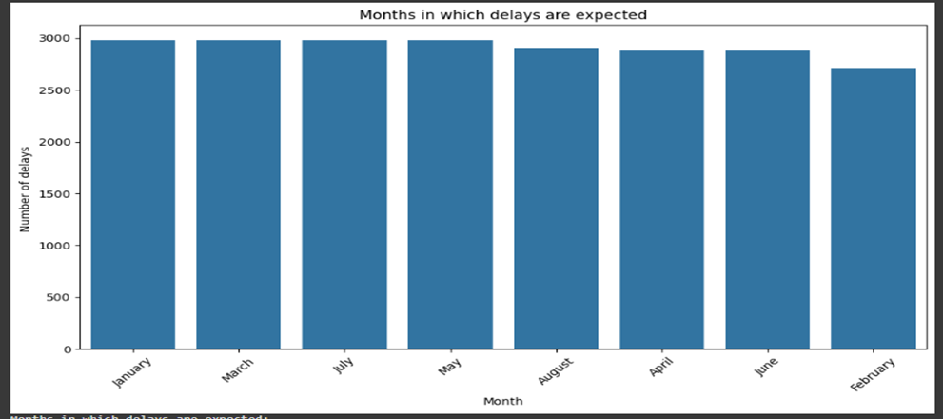
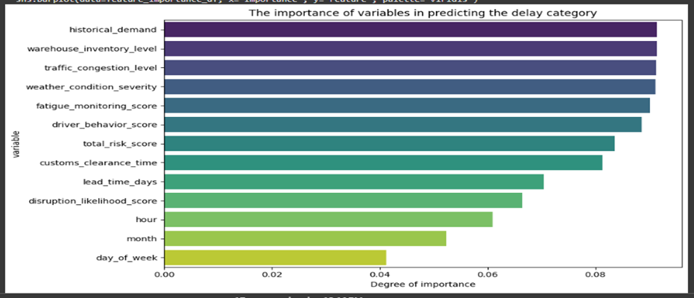
Expected delivery delays
What are the expected delay months?
Main reasons for delivery delays
Analysis: January, March, May, and July are expected to have the highest number of delivery delays at 2,976, while February is expected to have the lowest number at 2,712
Project Impact: The project contributes to reducing delays and increasing delivery efficiency by predicting critical periods in advance and making data-driven decisions.
Discussion topic: What are the expected delivery delay months and how can this information be used to improve logistics planning?
Analysis: Customs delays and traffic congestion are the main factors in delivery delays, with disruptions and driver behavior having a moderate impact.
Project impact: Improved accuracy of forecasting delivery delays, which helps in better planning supply chains, reducing operational losses, increasing customer satisfaction, and enhancing the overall efficiency of logistics operations.
Discussion topic: What are the main reasons for future delivery delays?

Slide 16
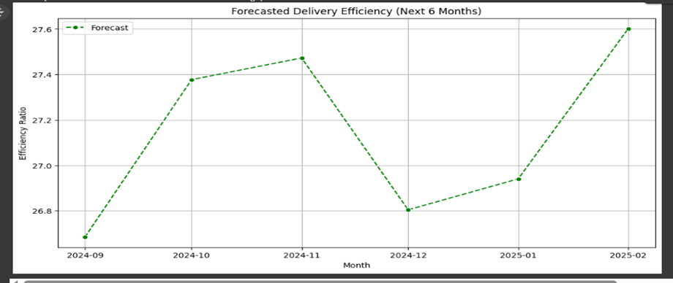
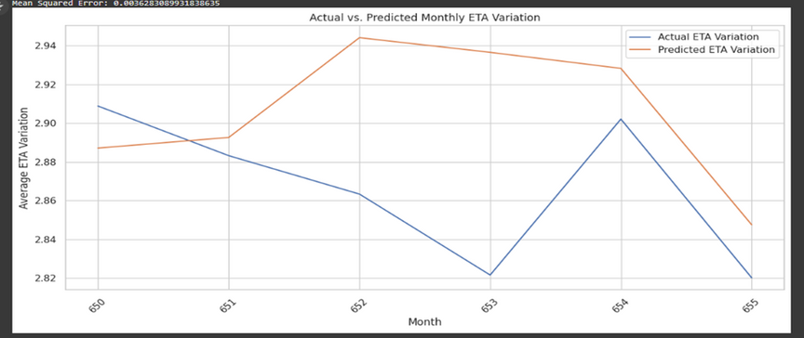
Effect of performance on conductivity
The impact of monthly changes on delivery efficiency
The effect of driver fatigue on ETA accuracy
Analysis: Delivery efficiency is high in October and November 2024, declines in December to 26.8, and then gradually improves to 27.6 in February 2025.
Project impact: Enables companies to accurately predict periods of reduced delivery efficiency, which helps improve operational planning, better allocate resources, and reduce delays.
Discussion topic: How do monthly performance changes affect delivery efficiency?
Analysis: This indicates the relationship between driver fatigue and its impact on the accuracy of expected time of arrival (ETA) estimates. Using average fatigue scores from previous months, the variance in ETA can be predicted for the current month.
Project Impact: The project helps improve delivery timeliness by anticipating the impact of driver fatigue, reducing delays and increasing operational efficiency.
Discussion topic: How does driver fatigue affect the accuracy of expected time of arrival (ETA) estimates?

Slide 17

Dashboard Overview

Slide 18
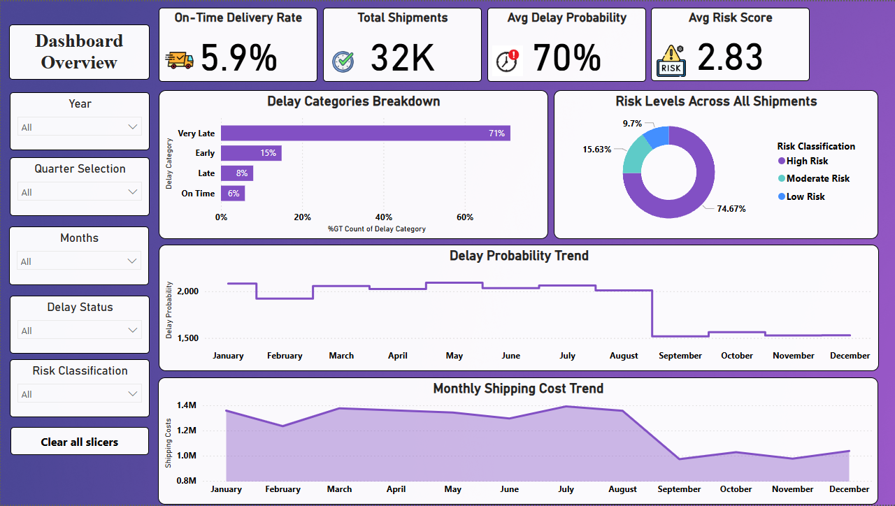
Dashboard

Slide 19
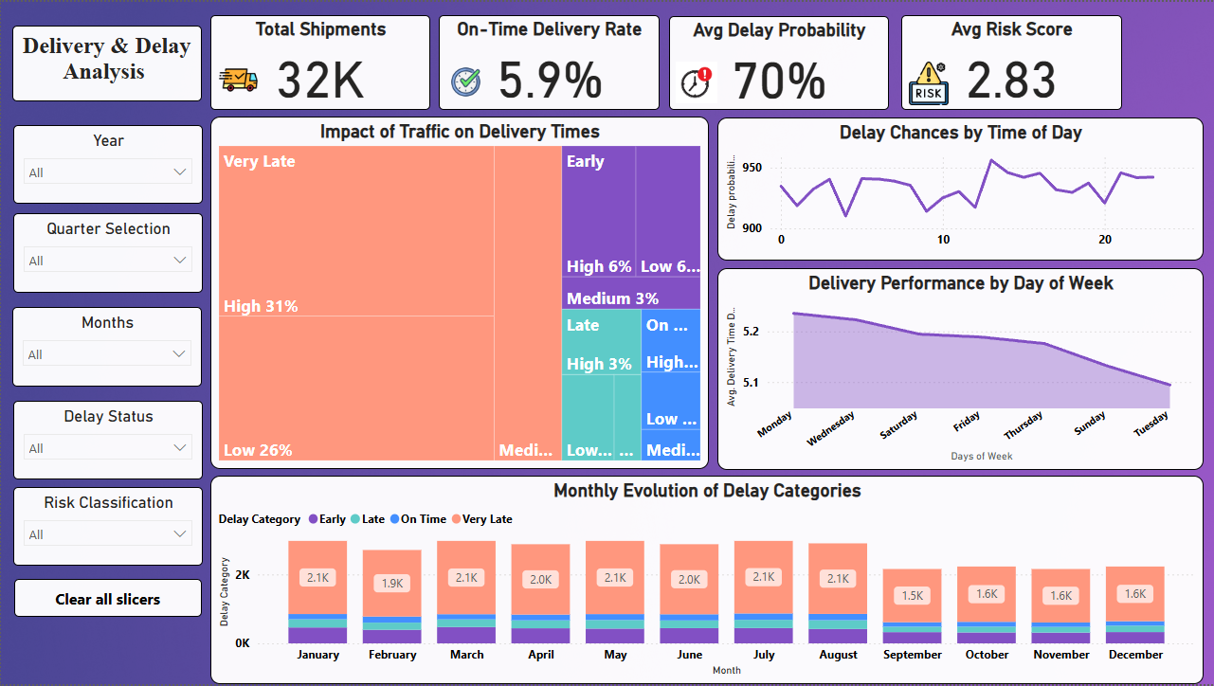
Dashboard

Slide 20
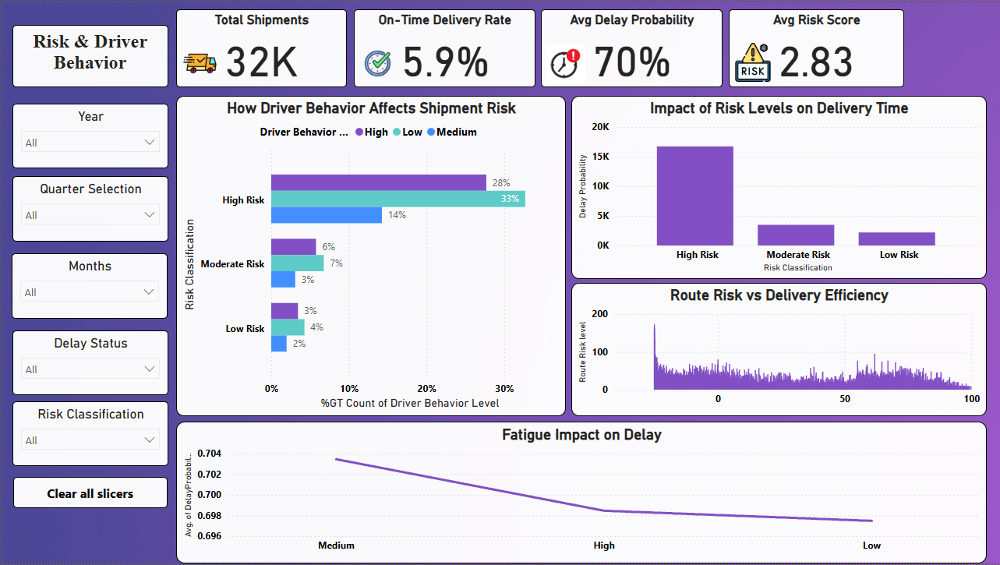
Dashboard

Slide 21
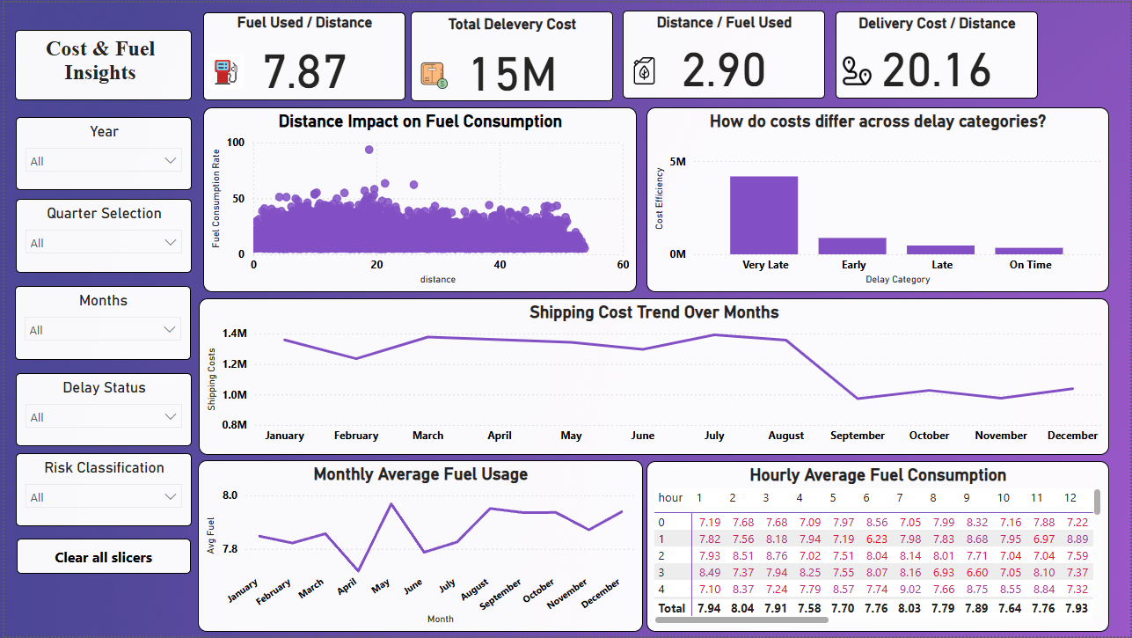
Dashboard

Slide 22
Key Insights
Delivery Performance Overview
Alarmingly Low On-Time Delivery Rate: Only 5.9% of shipments are delivered on time, indicating a critical performance issue.
High Average Delay Probability: 70% average delay probability suggests that a large majority of shipments are expected to be late.
Dominant "Very Late" Deliveries: 71% of delayed shipments fall into the "Very Late" category, highlighting the severity of delays.
Risk and Driver Behavior Analysis
Significant "High Risk" Shipments: 15.6% of shipments are classified as "High Risk," posing potential operational challenges.
Strong Link: High-Risk Driver Behavior & Shipment Risk: Shipments associated with "High Risk" driver behavior are more likely to be classified as "High Risk."

Slide 23
Key Insights
Cost and Fuel Insights
Average Fuel Consumption & Efficiency: Average Fuel Used / Distance is 7.87, and Distance / Fuel Used is 2.90.
Total Delivery Cost: Total Delivery Cost is 15 M.
Cost per Distance: Average Delivery Cost / Distance is 20.16.
Costly "Early" Deliveries: Surprisingly, "Early" deliveries contribute to higher costs, similar to "Very Late" deliveries.
Temporal Fuel Consumption Patterns: Fuel usage varies by month and hour of the day.
Temporal Delivery Trends
Monthly Delay Probability Fluctuations: Delay probability varies throughout the year, with a notable dip in September.
Day-of-Week Delivery Performance Variation: Delivery performance appears slightly lower at the beginning of the week (Monday & Tuesday).
Monthly Shipping Cost Trends: Shipping costs fluctuate throughout the year, with a notable decrease in September.

Slide 24
Recommendations
Conduct a detailed investigation into the primary causes of "Very Late" deliveries and implement targeted strategies to improve on-time performance.
Develop specific handling protocols for "High Risk" shipments aimed at minimizing potential delays and analyze the factors contributing to "High Risk" classifications.
Implement targeted training and coaching programs for drivers exhibiting "High Risk" behaviors.
implement strategies such as route optimization and driver training to reduce overall fuel consumption and costs.
explore the potential of transitioning to alternative fuel vehicles or electric vehicles to reduce fuel costs and environmental impact.

Slide 25
THANK YOU

